Slide 1
Bees to Honey
By: Luke Weber

Slide 2
Introduction
I found a data set on Kaggle covering several metrics related to honey bee production and its value in the United States from the year 1995 up until 2021. Across several US states for each year the data set contains relevant information on the amount of bee colonies, the honey yield per colony, and the total amount of honey produced. As well as the average price per pound of honey and the total value of the honey production.
I will be using RStudio to analyze the data set and create the linear regression model for each relationship with the entire US and individual states. The GitHub and R file are shared below. The R file details each step of the process and we will go through the file in the linear regression model section.
https://www.kaggle.com/datasets/mohitpoudel/us-honey-production-19952021.
https://github.com/Lukew69/Honey-Production.

Slide 3
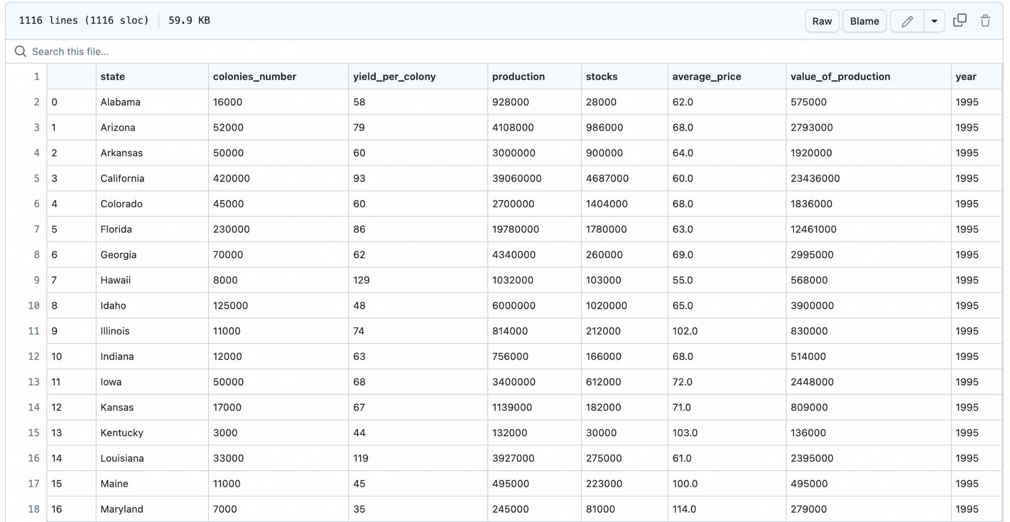
The Data
The first thing after opening the data set in R that is catching is that the data set only includes forty four of the fifty United States. Alaska, Delaware, Connecticut, Massachusetts, New Hampshire, and Rhode Island are absent from the data set. It is not completely damaging, we can continue on with the model, just note that those states are not represented in any of the models.

Slide 4
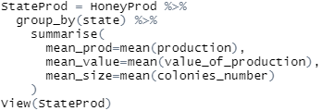
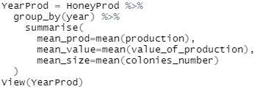
Secondly and the most glaring problem is that the data set is not necessarily independent. Take for example the two data points Alabama 1995 and Arizona 1995 these may be independent but we will have Alabama again for the year 1996. Alabama 1996 is not independent from Alabama 1995.
The same state is not independent in sequential years. This violates one of the assumptions of the linear regression model. We can create independence by taking the averages of each state for every year. So instead of having Alabama 1995, Alabama 1996, … Alabama 2021 we just have Alabama.
R code for creating independent data by state.
R code for creating independent data by year.

Slide 5
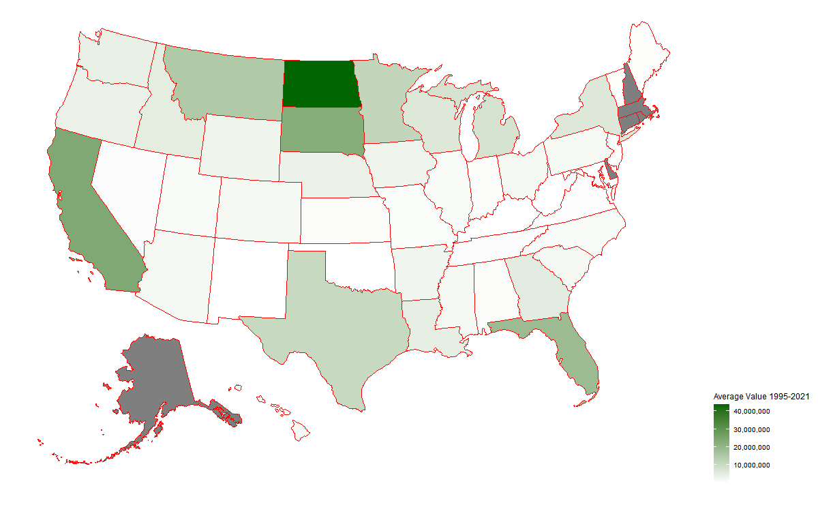
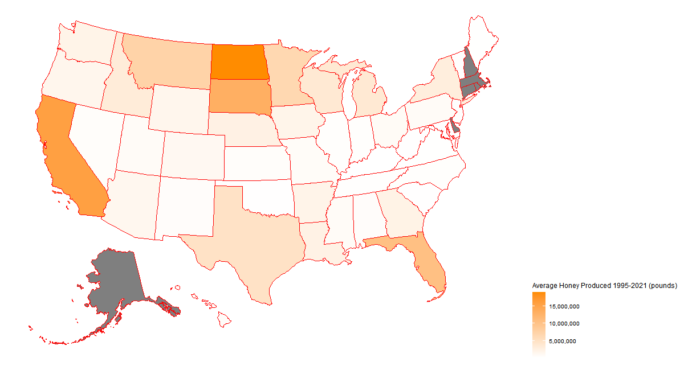
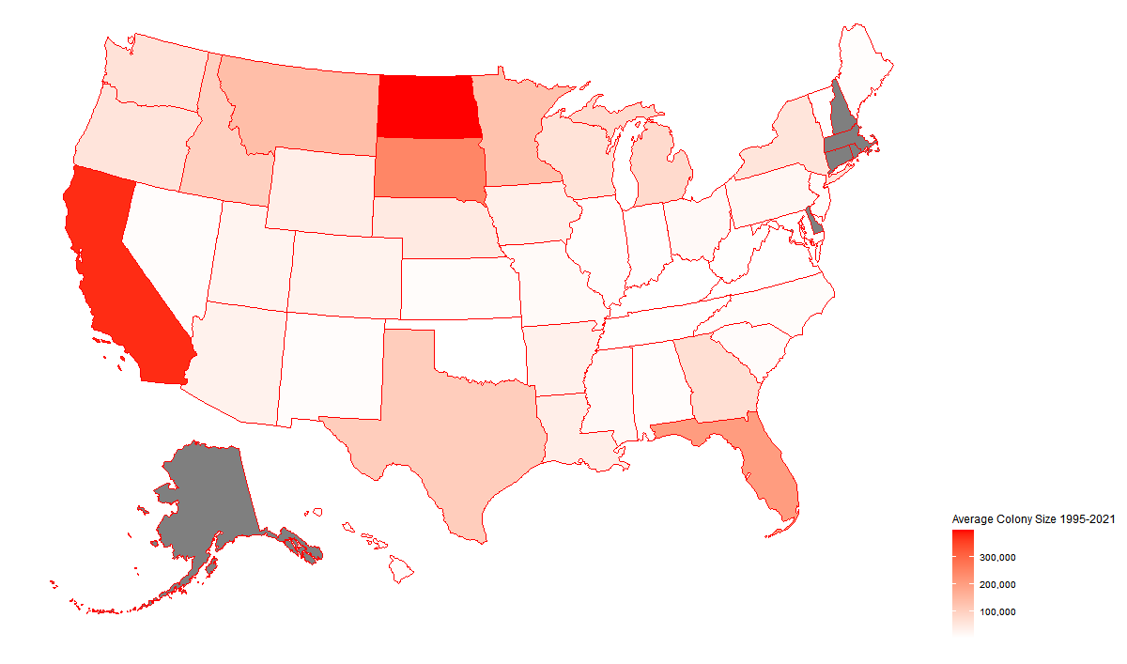
Heat Maps
Heat map for the average amount of honey produced (pounds) during 1995-2021 for each state.
Heat map for the average value of the production (dollars) during 1995-2021 for each state.
Heat map for the average number of producing bee colonies during 1995-2021 for each state.
Using the state production data from the previous slide we can create a unique visualization of our data.
The grey states are the six states not represented in the data.

Slide 6
Linear Regression Per State
With a pretty good idea that there is some relationship between the three variables we want to confirm that their relationship is linear in order to do a linear regression. If not this presentation is about to end abruptly.
I am interested in seeing the relationship between colony size and the amount of honey produced as well as colony size and the total value of the honey.
The next two slides will have the R code, the output, and the plot for each model.

Slide 7
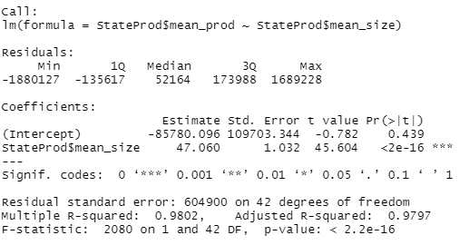
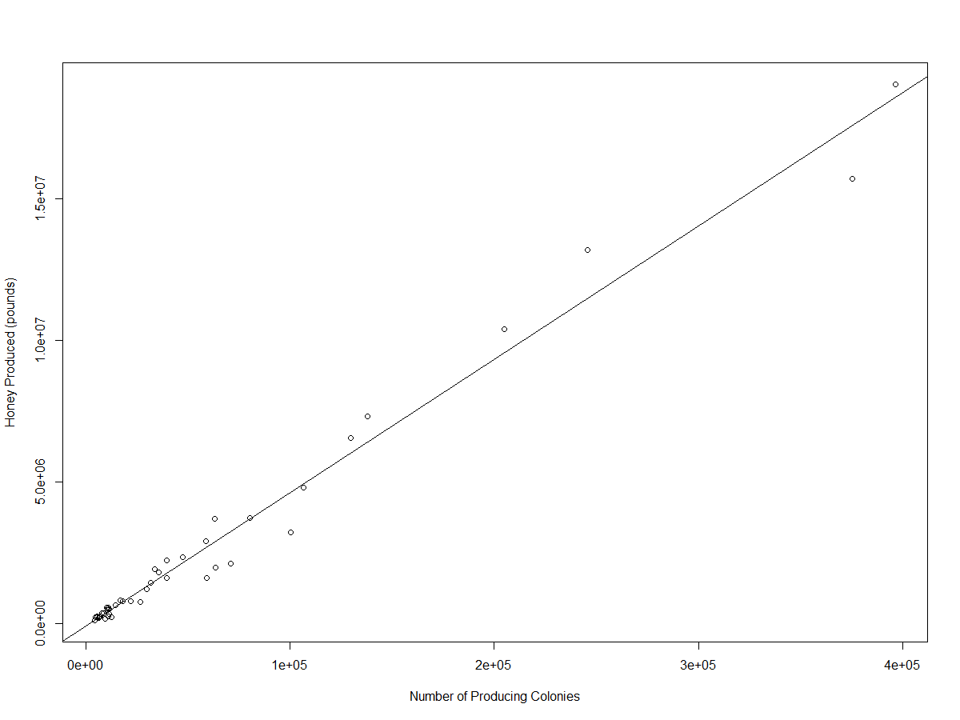
Linear Regression Mean Size by Mean Production
(Average Honey Produced) = 47(Average Number of Colonies) - 85,780

Slide 8
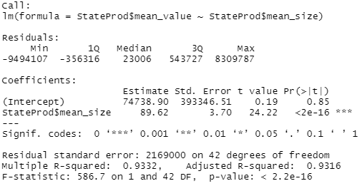
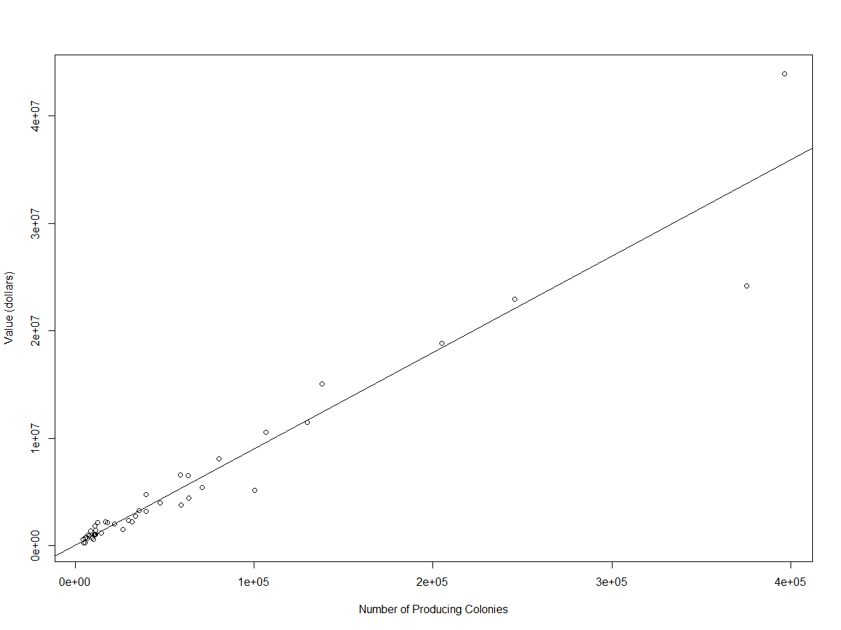
Linear Regression Mean Size by Mean Value
(Average Value of Production) = 89.6(Average Number of Colonies) + 74,738

Slide 9
Linear Regression Per Year
There is no need to create a visual of the average per year data set since it is one point per year. We could only make a bar graph or plot, and when we look at the linear regression we will make a plot for it. Additionally the data is already in order by the year.
I am interested in the trend per year and seeing how honey production, colony size, or value change with each year.
The next three slides will have the R code, the output, and the plot for each model.

Slide 10

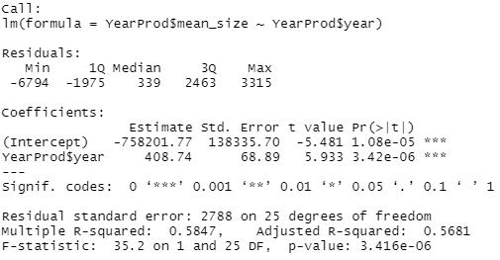
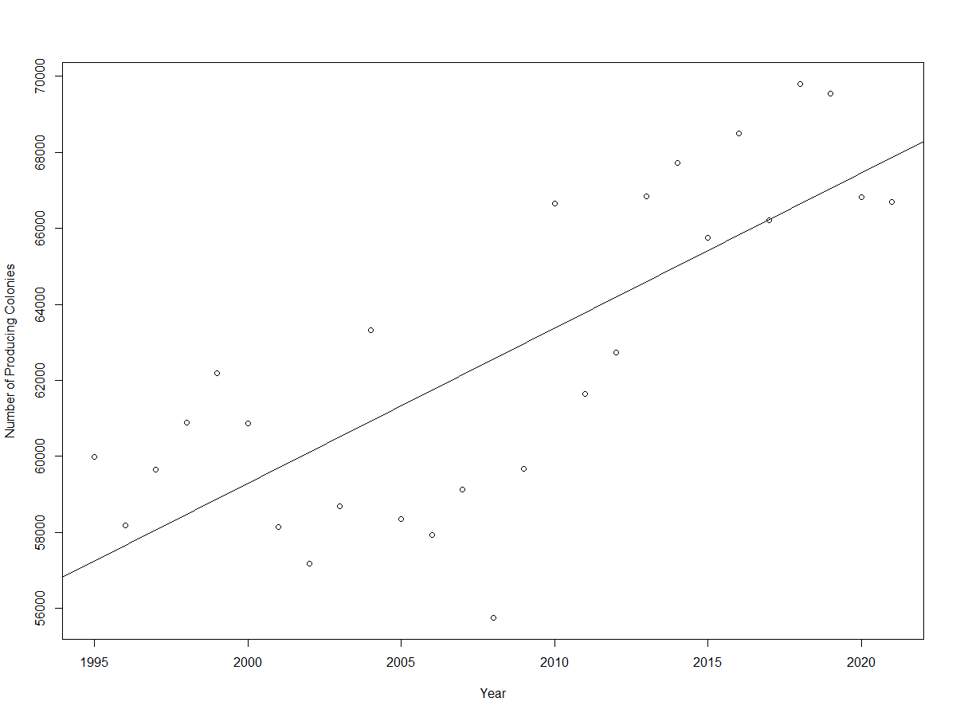
Linear Regression Year by Mean Colonies
(Average Number of Colonies) = 408(Year) - 758,201

Slide 11

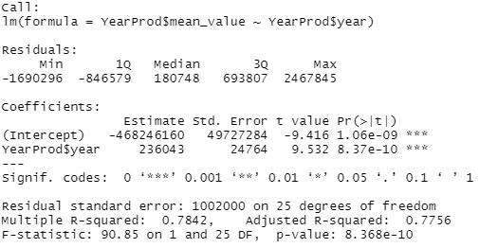
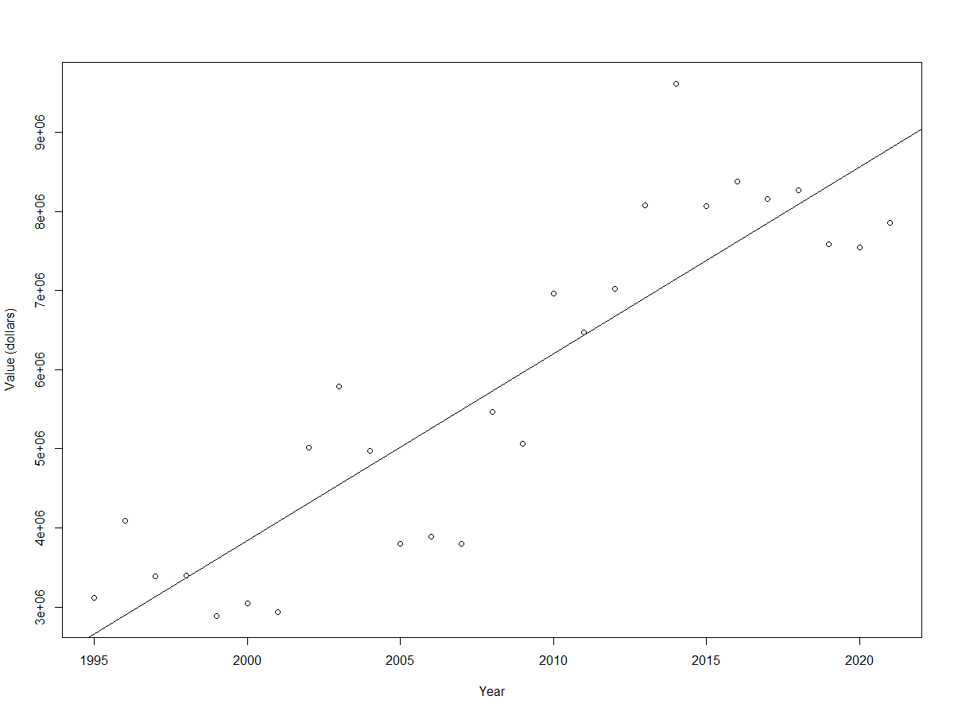
Linear Regression Year by Mean Value
(Average Value of Production) = 236,043(Year) - 468,246,160.

Slide 12

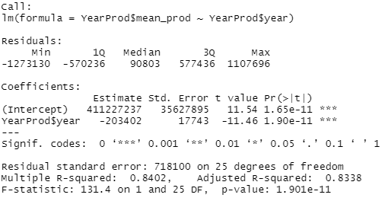
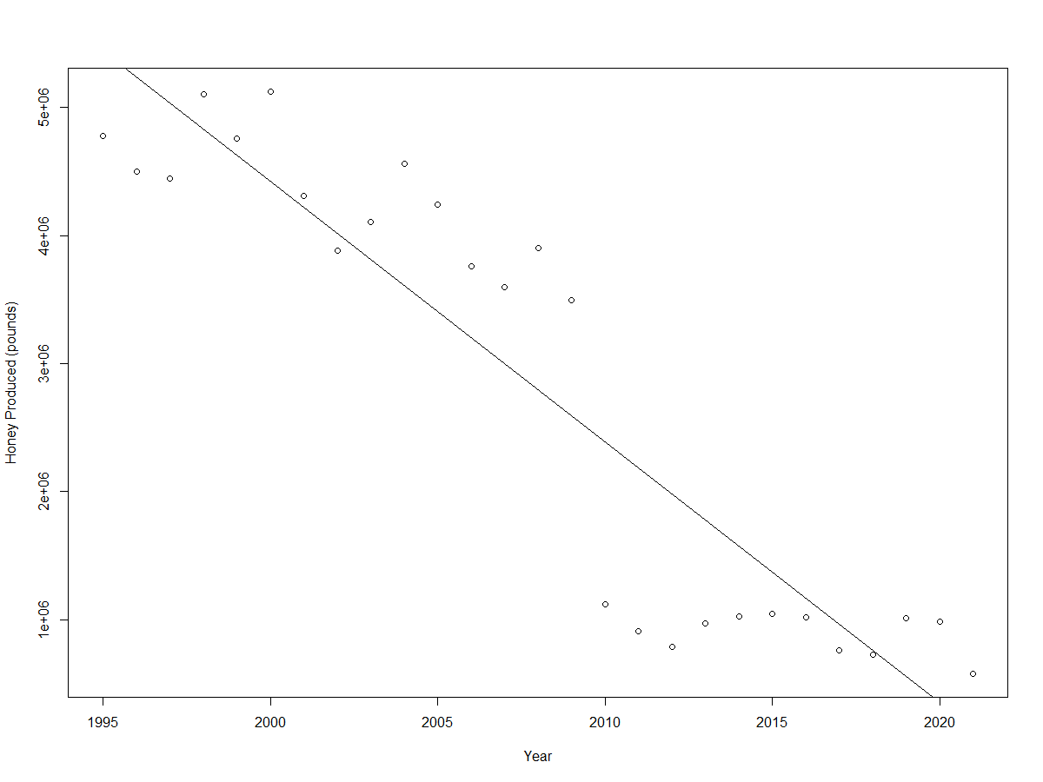
Linear Regression Year by Mean Production
(Average Honey Produced) = -203,402(Year) + 411,227,237.

Slide 13
Conclusion
It is interesting to note that the average amount of colonies and the average value of production trend upwards each year, but the average amount of honey trends downward each year. This seems to contradict the state grouped linear models, but that is not necessarily the case. For example looking at North Dakota and averaging the variables for each year, you end up with North Dakota having the most producing colonies and the most honey produced. It does not matter if one of those variables decreased year to year , on average the states with more colonies produce more honey.
All of the models have a good correlation (r), good adjusted r ², and a low p-value.
I feel like the year averaged models are the most interesting to look at and they tell the best story, but the state averaged models are the most useful.
The heat map is an extremely helpful visualization tool for this data as it allows a real life geographical representation. It is very easy to read and understand the story of the data.
Overall the linear regression models for the averages are strong and allow good insight into the relationships between the number of colonies, honey produced, and production value.

